Slide 1
Measure of metrics Degree, Eigenvector and Katz Centrality
MA 653: Network Science
Instructor: Ashok Singh Sairam
ashok@iitg.ac.in

Slide 2
Detecting community structure
Want to calculate a weight w_{ij} for every pair i, j of vertices in the network
One possible way to calculate weight: the number of node-independent paths between vertices
Node-independent path: Two paths are node independent (aka vertex independent) if they share no nodes other than the starting and ending vertices
A
B
A
B

Slide 3
Independent paths and connectivity
Two paths connecting a given pair of vertices are edge independent if they share no edges
Two vertex-independent paths are also edge-independent (the opposite is not true)
The number of independent paths between a pair of vertices is called connectivity of the vertices

Slide 4
Ex: Independent paths and connectivity
Find the number of edge independent (Ans=> 2) and vertex independent (Ans=> 1) paths between nodes A and B.
A
B

Slide 5
Cut set: vertex cut set
A cut set (or more properly vertex cut set), is a set of vertices whose removal will disconnect a specified pair of vertices
This set can be thought as the bottleneck for the connectivity of this specific pair of nodes
For example, the node C form cut set of size 1 for the nodes A and B
A
C
B

Slide 6
Cut set: edge cut set
An edge cut set, is a set of edges whose removal will disconnect a specified pair of vertices
A minimum cut set is the smallest cut set that will disconnect a specified pair of vertices
Cut set need not be unique as can be seen from this example
W
X
A
B
Y
Z

Slide 7
Menger’s theorem
The size of the minimum vertex cut set is equal to the number of vertex-independent paths between the same nodes
The choice of the vertex is also important
Example: Cut set is 2 for nodes A and B
but removing W and Z will not disconnect,
while removing X and Y will disconnect
The same holds true for edges
The edge version of the theorem is important for the maximum flow problem
W
X
A
B
Y
Z

Slide 8
Max-flow/min-cut theorem
In the general case we have weighted networks
Minimum edge cut set is a cut set such that the sum of the weights on the edges has the minimum possible value
The maximum flow between a given pair of vertices in a network is equal to the sum of the weights on the edges of the minimum edge cut set that separates the same two vertices
Intuitively, the “low” weight edges form bottlenecks that do not allow the flow between the two vertices to increase.

Slide 9
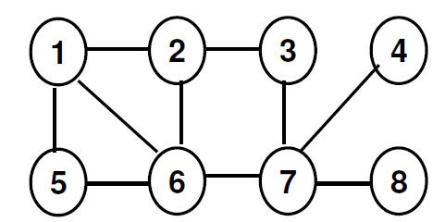
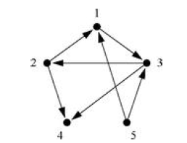
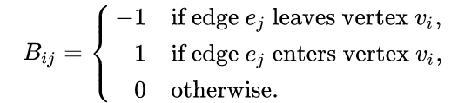
Review
Find the diameter of the network => 3(??)
Write down the incidence matrix of the network.
It is a n x m matrix B, where n and m are the number of vertices and edges, respectively s.t.
A simple network consists of n nodes in a single component. What is the maximum possible number of edges it could have? What is the minimum number of edges it could have? => nC2 & n-1

Slide 10
Centrality
Centrality is a widely studied concept
What is centrality?
Quantification of the intuitive notion of the importance of a node in a network
The most important/central nodes in a network
Centrality is generally computed per vertex
We will refer to the centrality of a vertex i as x_{i} or c_{i}

Slide 11
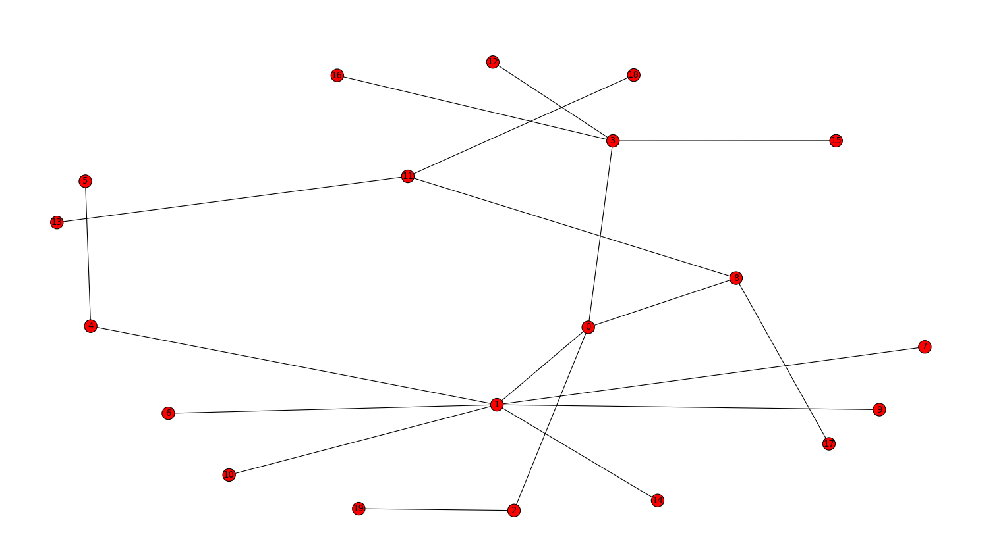
Degree Centrality
What makes a node central in a network?
Lots of one-hop connections from the node
degree centrality
Lots of one-hop connections from the node relative to the size of the graph
Normalized degree centrality

Slide 12
Degree centrality
The simplest centrality metric is degree centrality
It is simply the degree of node
For a directed network we have in- and out-degree centralities
Each one appropriate for different circumstances
Simple, yet illuminating measure
Social network → nodes of high degree might be thought of as one with access to more information sources, with more prestige, etc.
Citation network → a paper with more citations (in-degree centrality) might be roughly thought of as influential

Slide 13
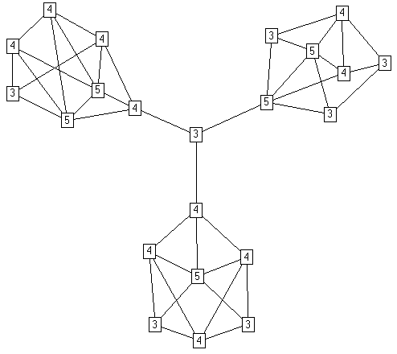
Another example
Degree centrality, however, can be deceiving, because it is a purely local measure

Slide 14
Eigenvector centrality
Degree centrality assumes all neighbors are equal → Only the number of neighbors matter
However, in many circumstances the importance of a vertex increases if it is connected to important nodes → eigenvector centrality
Assume initially everyone has score x_{i}=1 and we update its centrality using the sum of the scores/centralities of his neighbor’s
k⁻¹ is the constant of probability

Slide 15
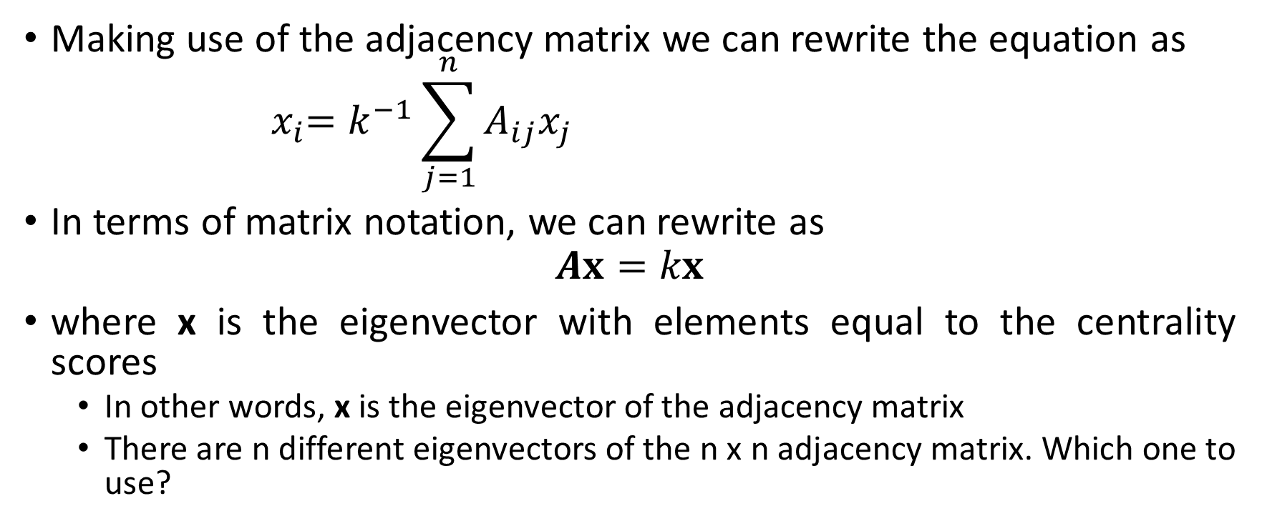
Eigenvector centrality
Making use of the adjacency matrix we can rewrite the equation as
$${ x}_{i}=k^{−1}\sum_{j=1}^{n}{A_{ij}x_{j}}$$
In terms of matrix notation, we can rewrite as
$$Ax=kx$$
where x is the eigenvector with elements equal to the centrality scores
In other words, x is the eigenvector of the adjacency matrix
There are n different eigenvectors of the n x n adjacency matrix. Which one to use?

Slide 16
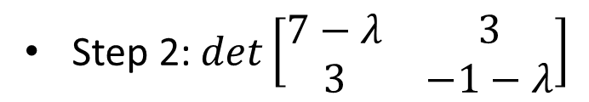

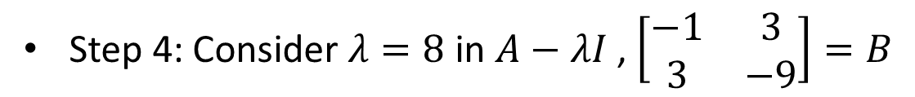
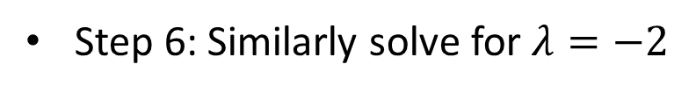
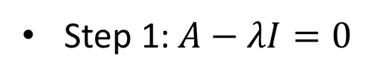
Finding eigenvalues and eigenvectors
$A=\left[\begin{matrix}7 & 3 \\ 3 & −1\end{matrix}\right]$
Step 1: $A−λI=0$
Step 2: $det\left[\begin{matrix}7−λ & 3 \\ 3 & −1−λ\end{matrix}\right]$
Step 3: Solve for $λ$, $λ=8 , −2$ are the eigenvalues
Step 4: Consider $λ=8$ in $A−λI$ , $\left[\begin{matrix}−1 & 3 \\ 3 & −9\end{matrix}\right]=B$
Step 5: Solve $Bx=0$, $x=\left[\begin{matrix}3 \\ 1\end{matrix}\right] is the eigenvector for λ=8$
Step 6: Similarly solve for $λ=−2$

Slide 17
Perron Frobenius Theorem
We will use the following result
Perron Frobenius theorem: A real square matrix with positive entries has a unique largest real eigenvalue and that the corresponding eigenvector has strictly positive components
This means, for a matrix like adjacency matrix with all elements non-negative, there is only one eigenvector that has all elements non-negative
The leading eigenvector
Thus the value of k must be equal to the largest eigenvalue

Slide 18
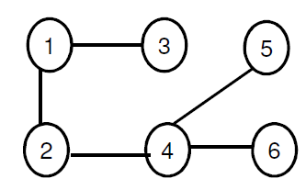

Computing Eigen vector centrality
Power iteration is one of many eigenvalue algorithms that may be used to find this dominant eigenvector.
Find x(1). What does it represent?
$x(1)=\left(\begin{aligned}\begin{matrix}0 & 1 & 1 \\ 1 & 0 & 0 \\ 1 & 0 & 0\end{matrix} \begin{matrix}0 & 0 & 0 \\ 1 & 0 & 0 \\ 0 & 0 & 0\end{matrix} \\ \begin{matrix}0 & 1 & 0 \\ 0 & 0 & 0 \\ 0 & 0 & 0\end{matrix} \begin{matrix}0 & 1 & 1 \\ 1 & 0 & 0 \\ 1 & 0 & 0\end{matrix}\end{aligned}\right)\left(\begin{matrix}\begin{aligned}1 \\ 1 \\ 1 \\ 1 \\ 1\end{aligned} \\ 1\end{matrix}\right)$=?
Compute x(2), x(3) and so on

Slide 19
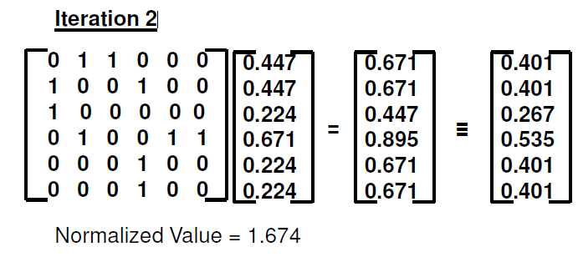
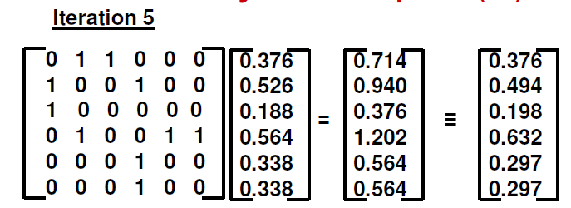
……………
Stop when the eigenvector
value converges

Slide 20
Steps to compute Eigenvector centrality
Start with an initial centrality vector x.
Multiply the adjacency matrix A by x to get x(1).
Normalize the resulting vector.
Repeat steps 2 and 3 until x converges to the dominant eigenvector

Slide 21
Eigenvector centrality for directed networks
For directed graphs, the adjacency matrix is general asymmetric
Thus, we can compute the Eigenvector centrality based on the out-degree and the in-degree
A node is considered to be more important if it has out-going links to nodes that in turn have a larger out-degree (i.e., more out-going links)
A node is considered to have a higher “prestige”, if it has in-coming links from nodes that themselves have a larger in-degree (i.e., more in-coming links)
We get two leading eigenvectors
“left” eigenvector corresponds to out-edges
“right” eigenvector corresponds to in-edges
Which one to use?

Slide 22
Eigenvector centrality for directed networks
In most cases, we use the right eigenvector
The centrality in most of the cases is conferred by other vertices pointing towards you
where x is the right leading eigenvector
Justification: Centrality is bestowed by other nodes pointing towards you
Ex: On WWW, a page is considered important if other pages point towards it
One can set up a page that points to thousand other pages, but that does not make the page important

Slide 23
Issues: Eigenvector centrality for directed networks
What is the eigenvector centrality of A ?
Of B ?
Only vertices that are in a strongly connected component of two or more vertices, or the out-component of a strongly connected component can have non-zero eigenvector centrality.
In acyclic graphs, such as citation network, there are no strongly connected
components
eigenvector centrality is 0, that is completely useless

Slide 24
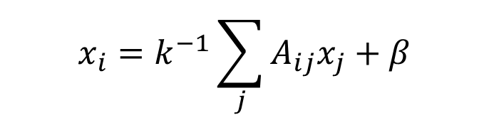
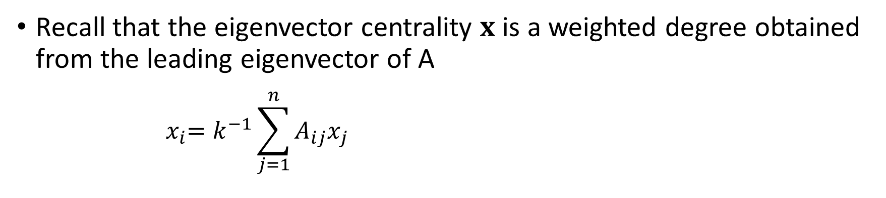
Katz centrality
Recall that the eigenvector centrality $x$ is a weighted degree obtained from the leading eigenvector of A
$${ x}_{i}=k^{−1}\sum_{j=1}^{n}{A_{ij}x_{j}}$$
Thoughts on how to modify the above formula for directed networks?
$$x_{i}=k^{−1}\sum_{j}{A_{ij}x_{j}+β}$$
where β is a constant initial weight given to each vertex so that its out degree matters.

Slide 25
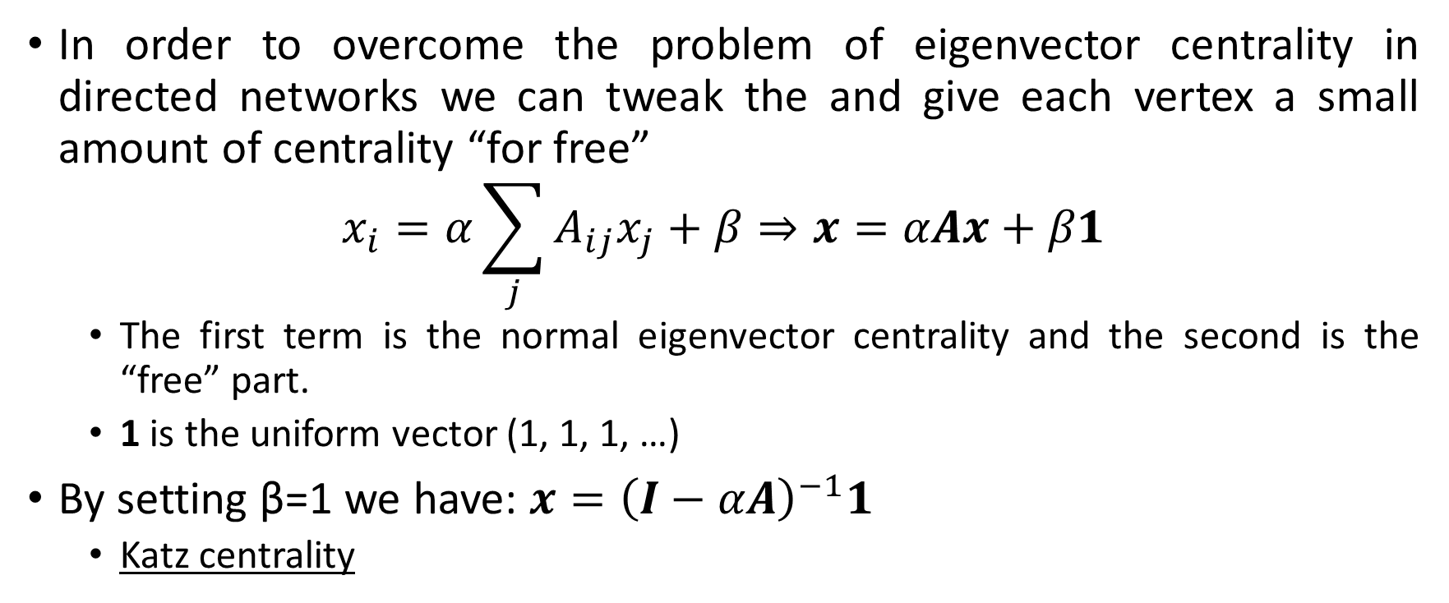
Katz centrality
In order to overcome the problem of eigenvector centrality in directed networks we can tweak the and give each vertex a small amount of centrality “for free”
$$x_{i}=α\sum_{j}{A_{ij}x_{j}+β⇒x=αAx+β1}$$
The first term is the normal eigenvector centrality and the second is the “free” part.
1 is the uniform vector (1, 1, 1, …)
By setting β=1 we have: $x={\left(I−αA\right)}^{−1}1$
Katz centrality

Slide 26
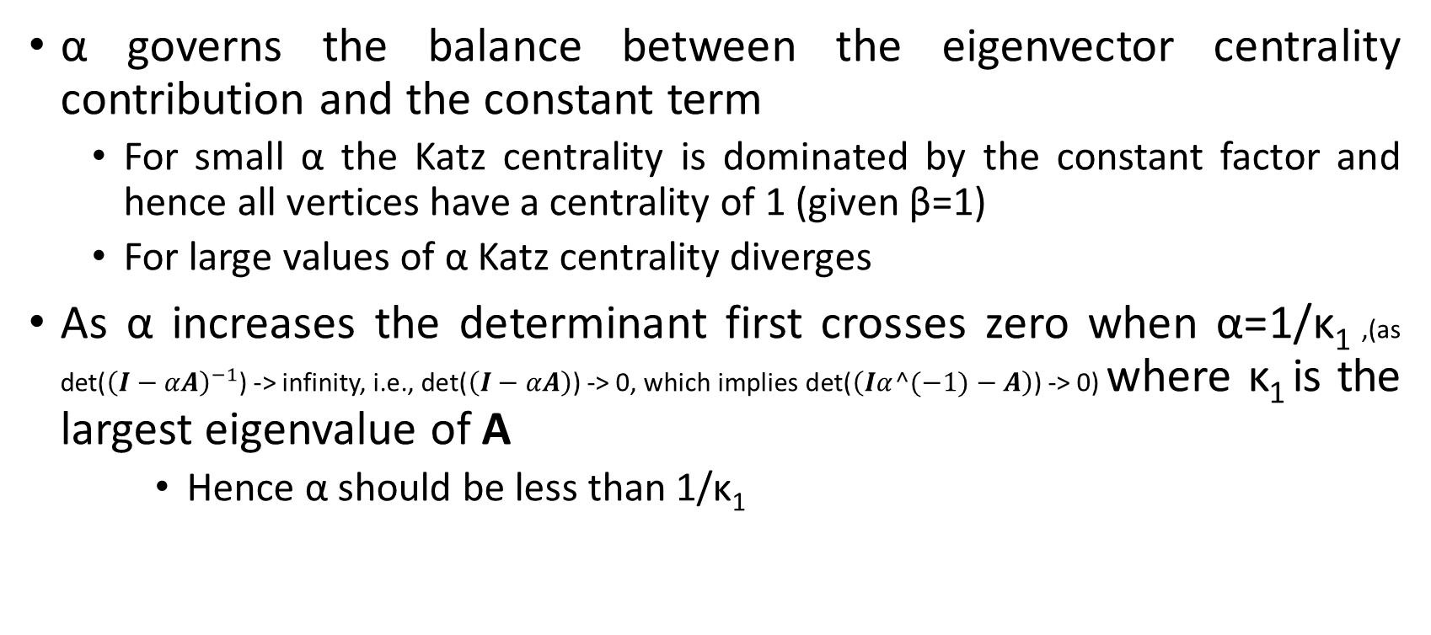
Choice of α
α governs the balance between the eigenvector centrality contribution and the constant term
For small α the Katz centrality is dominated by the constant factor and hence all vertices have a centrality of 1 (given β=1)
For large values of α Katz centrality diverges
As α increases the determinant first crosses zero when α=1/κ₁ ,(as det(${\left(I−αA\right)}^{−1}$) -> infinity, i.e., det($\left(I−αA\right)$) -> 0, which implies det($\left(Iα^(−1)−A\right)$) -> 0) where κ₁ is the largest eigenvalue of A
Hence α should be less than 1/κ₁

Slide 27
Extension of Katz centrality
A possible extension of the above definition is to assign different constant centrality to different vertices
β_{i} is some intrinsic, non-network contribution to the centrality for each vertex
E.g., in a social network the importance of an individual might depend on non-network factors as well, such as age or income etc.

Slide 28
Summary
Degree centrality: Lots of one-hop connections
Eigenvector centrality: Lots of one-hop connections to high centrality vertices
Katz centrality: Lots of one-hop connections to high out-degree vertices
When is it appropriate to use degree centrality?
When is it appropriate to use eigenvector centrality?
When is it appropriate to use katz centrality?

Slide 29
Review
Consider a connected k-regular undirected network (every node has degree k and there is only one component)
Show that the uniform vector 1=(1, 1, 1, …) is an eigenvector of the adjacency matrix with eigenvalue k.
Find the Katz centralities of all nodes in the network as a function of k.

